Slide 1
FORMATS OF LETTER
By: Wajiha M. Ismail

Slide 2
1. Block Format:
Block format features all elements of the letter aligned to the left margin of the page. It has a neat and simple appearance. Paragraphs are separated by a double line space.

Slide 3
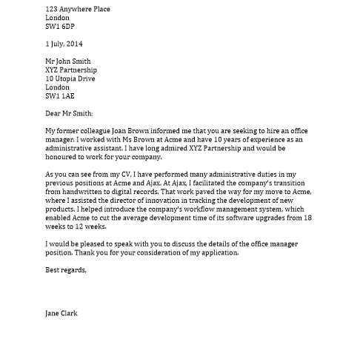
Block Format:

Slide 4
2. Modified Block Format:
Modified block differs from block style in that the date, sign off, and signature lines begin at the centre point of the page line. The beginning of each paragraph is indented five spaces, along with the subject line, if used. Depending on the length of the letter, paragraphs may be separated by a single or double line space.

Slide 5
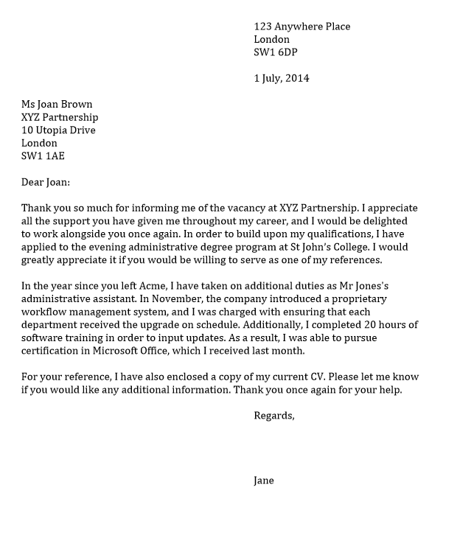
Modified Block Format:

Slide 6
3. Semi-Block Format:
Semi-block is similar to block but has a more informal appearance. All elements are left-aligned, except for the beginning of each paragraph, which is indented five spaces. Paragraphs are separated by a double line space.

Slide 7
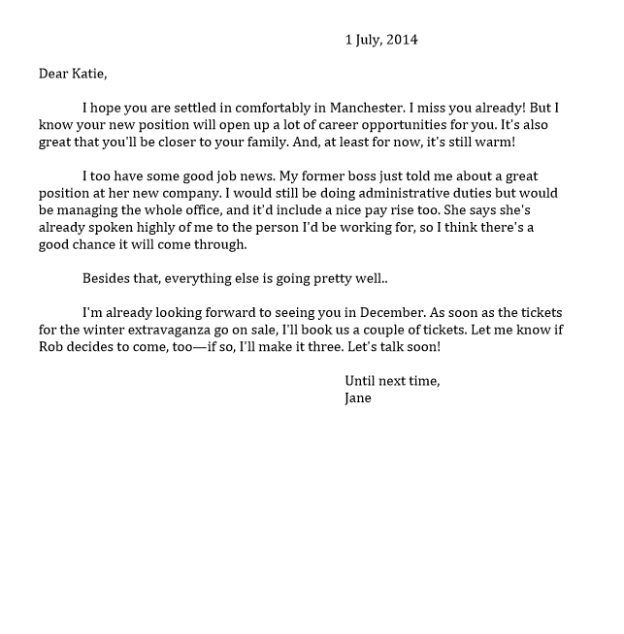
Semi-Block Format:

Slide 8
Thank You

